Slide 1
New Hiking and Tracking Leather Shoes

Slide 2
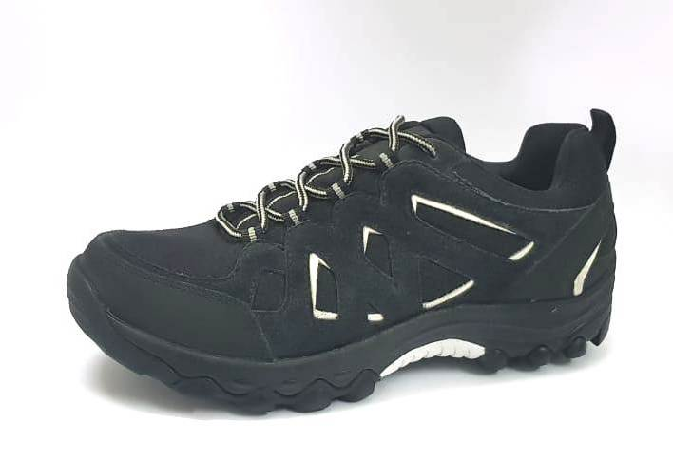
ART. NO | UPPER MATERIAL | COLOUR | LINING MATERIAL | SOLE
AW18-21 | LEATHER | BLACK/WHITE | SKINFIT | PHYLON WITH TPR RUNNER

Slide 3
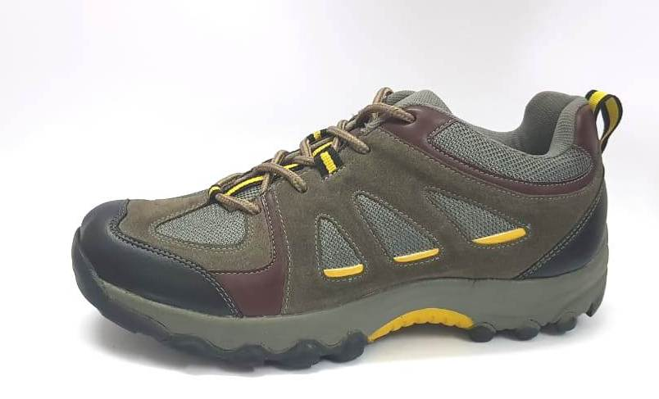
ART. NO | UPPER MATERIAL | COLOUR | LINING MATERIAL | SOLE
AW18-22 | LEATHER | GREY/BURGANDI/BLK | SKINFIT | PHYLON WITH TPR RUNNER

Slide 4
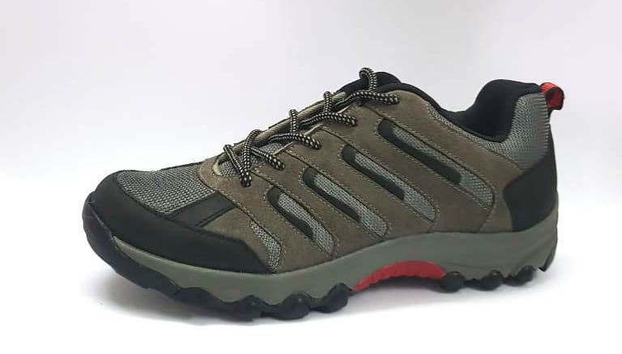
ART. NO | UPPER MATERIAL | COLOUR | LINING MATERIAL | SOLE
AW18-23 | LEATHER | GREY/BLK | SKINFIT | PHYLON WITH TPR RUNNER

Slide 5
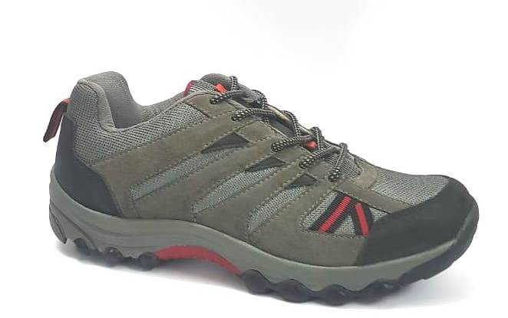
ART. NO | UPPER MATERIAL | COLOUR | LINING MATERIAL | SOLE
AW18-24 | LEATHER | GREY/BLK | SKINFIT | PHYLON WITH TPR RUNNER

Slide 6
New Hiking and Tracking PU SYN Shoes

Slide 7
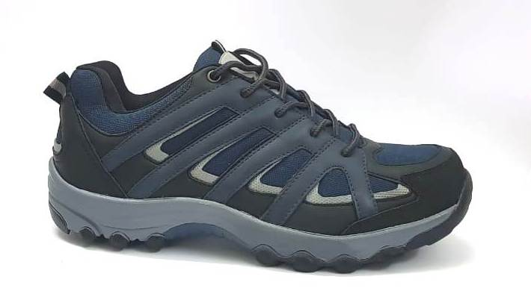
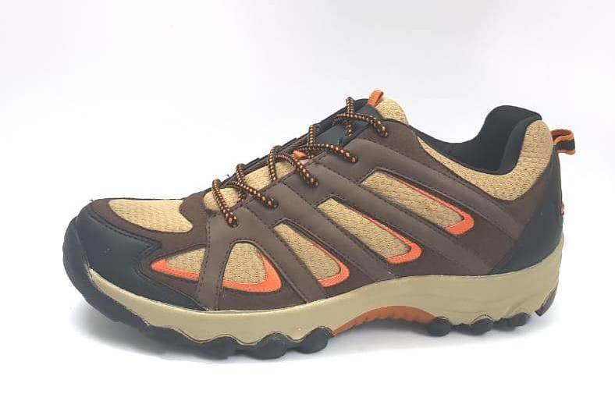
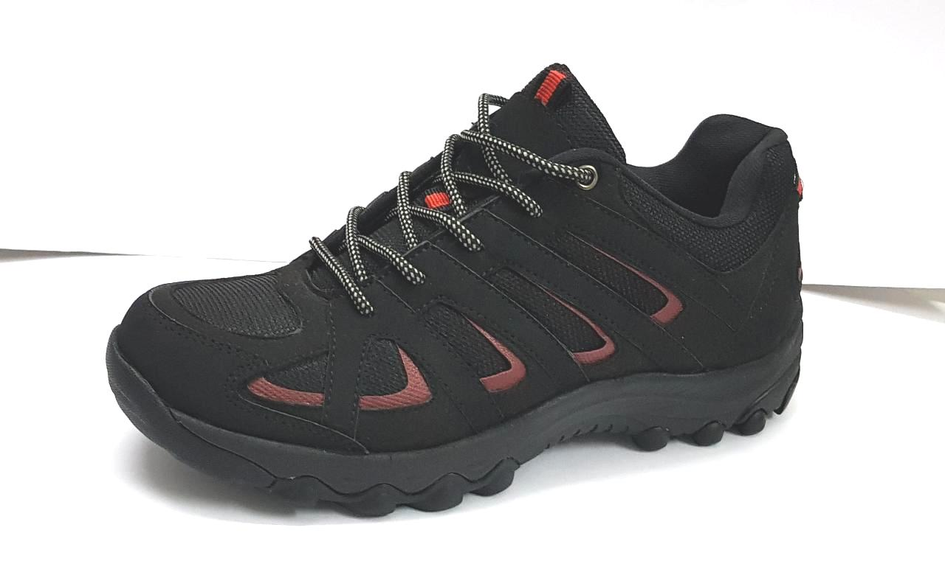
ART. NO | UPPER MATERIAL | COLOUR | LINING MATERIAL | SOLE
AW18-25A | PU SYN | NAVY/BLK | SKINFIT | PHYLON WITH TPR RUNNER
ART. NO | UPPER MATERIAL | COLOUR | LINING MATERIAL | SOLE
AW18-25B | PU SYN | BRN/CAMAL/BLK | SKINFIT | PHYLON WITH TPR RUNNER
ART. NO | UPPER MATERIAL | COLOUR | LINING MATERIAL | SOLE
AW18-25C | PU SYN | BLK | SKINFIT | PHYLON WITH TPR RUNNER

Slide 8
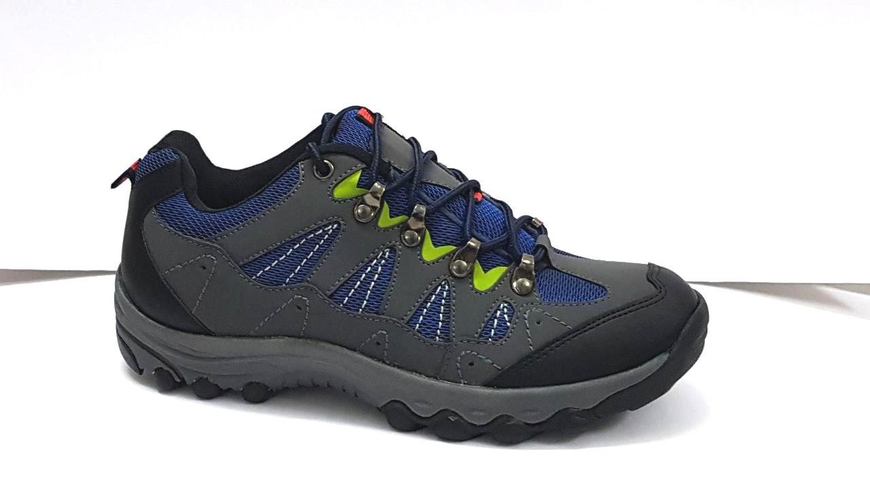
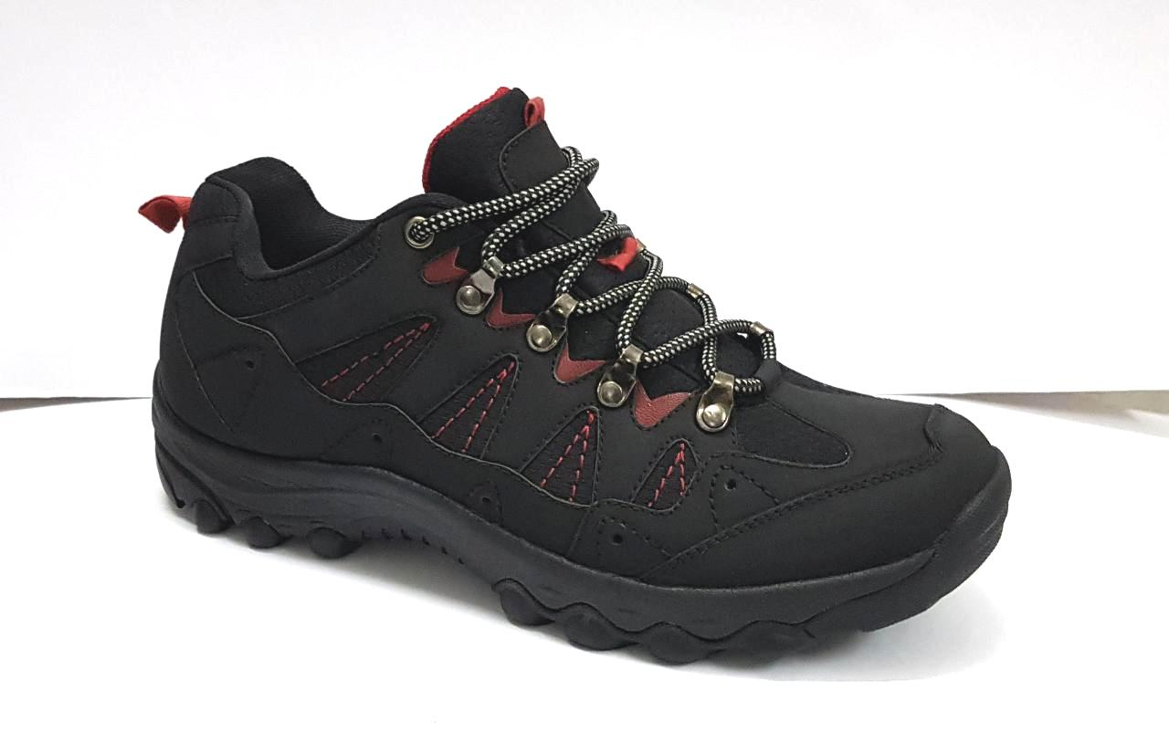
ART. NO | UPPER MATERIAL | COLOUR | LINING MATERIAL | SOLE
AW18-26A | PU SYN | GREY/NAVY/BLK | SKINFIT | PHYLON WITH TPR RUNNER
ART. NO | UPPER MATERIAL | COLOUR | LINING MATERIAL | SOLE
AW18-26B | PU SYN | BLK | SKINFIT | PHYLON WITH TPR RUNNER

Slide 9
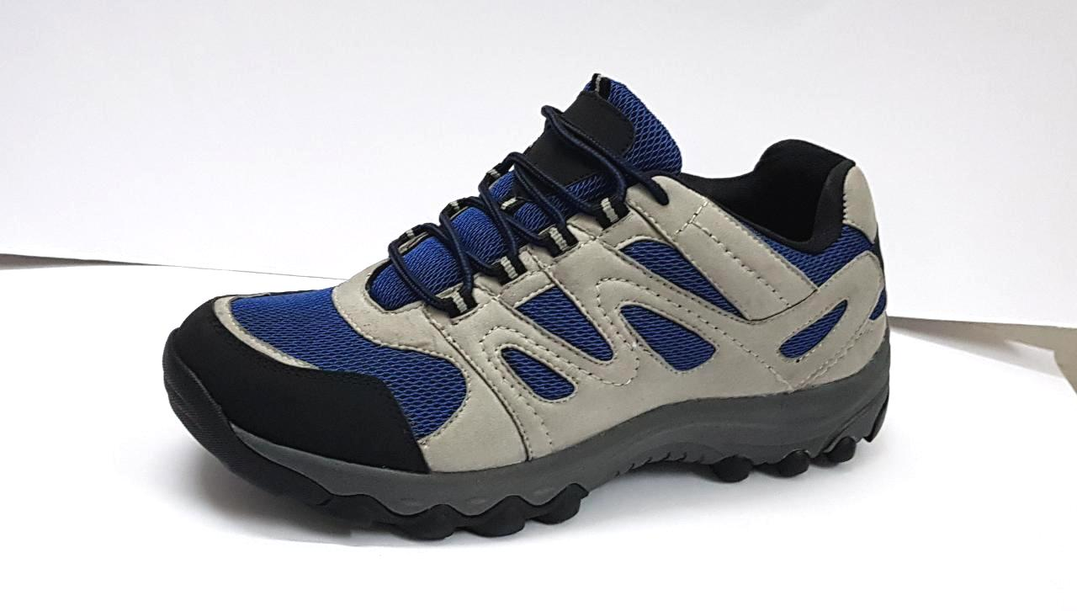
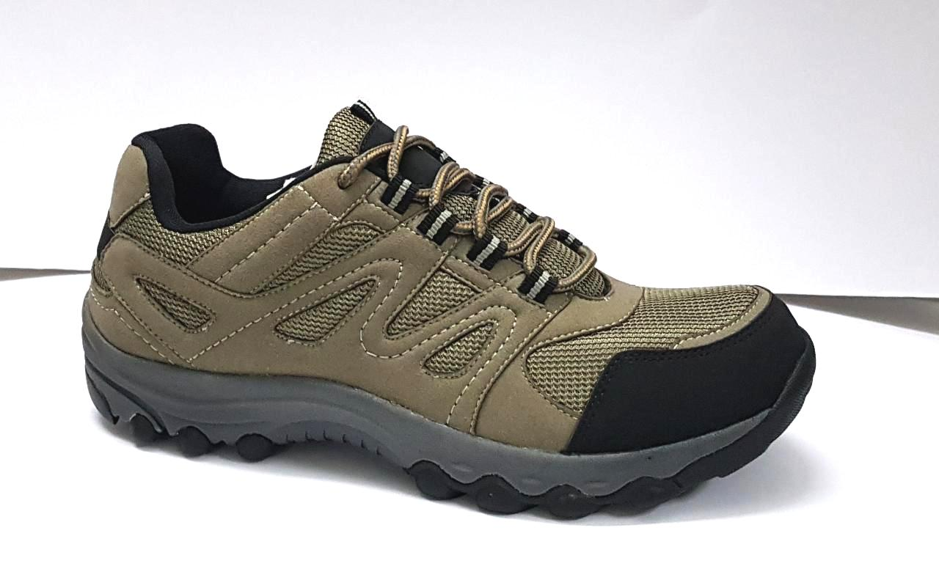
ART. NO | UPPER MATERIAL | COLOUR | LINING MATERIAL | SOLE
AW18-27A | PU SYN | LT.GREY/BLUE/BLK | SKINFIT | PHYLON WITH TPR RUNNER
ART. NO | UPPER MATERIAL | COLOUR | LINING MATERIAL | SOLE
AW18-27B | PU SYN | GREY/BLK | SKINFIT | PHYLON WITH TPR RUNNER

Slide 10
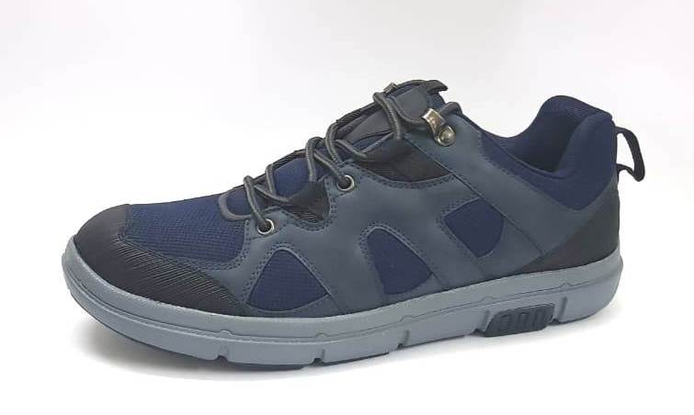
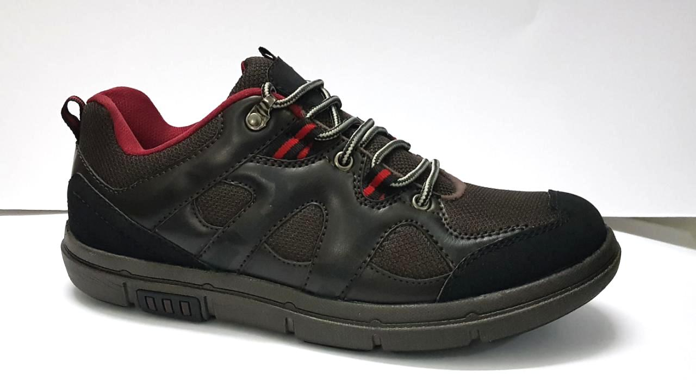
ART. NO | UPPER MATERIAL | COLOUR | LINING MATERIAL | SOLE
AW18-28A | PU SYN | NAVY/BLK | SKINFIT | PHYLON WITH TPR RUNNER
ART. NO | UPPER MATERIAL | COLOUR | LINING MATERIAL | SOLE
AW18-28B | PU SYN | BLK | SKINFIT | PHYLON WITH TPR RUNNER

Slide 11
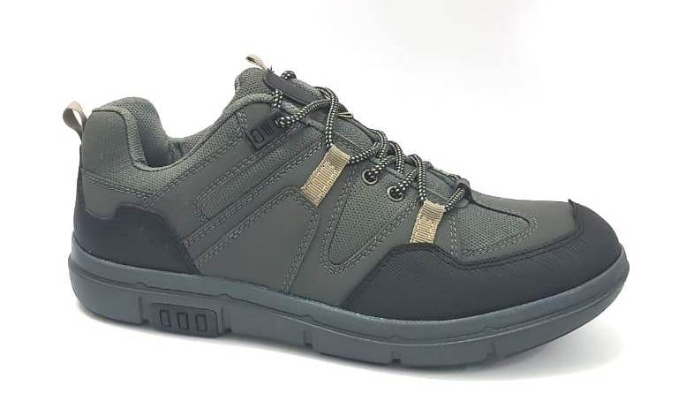
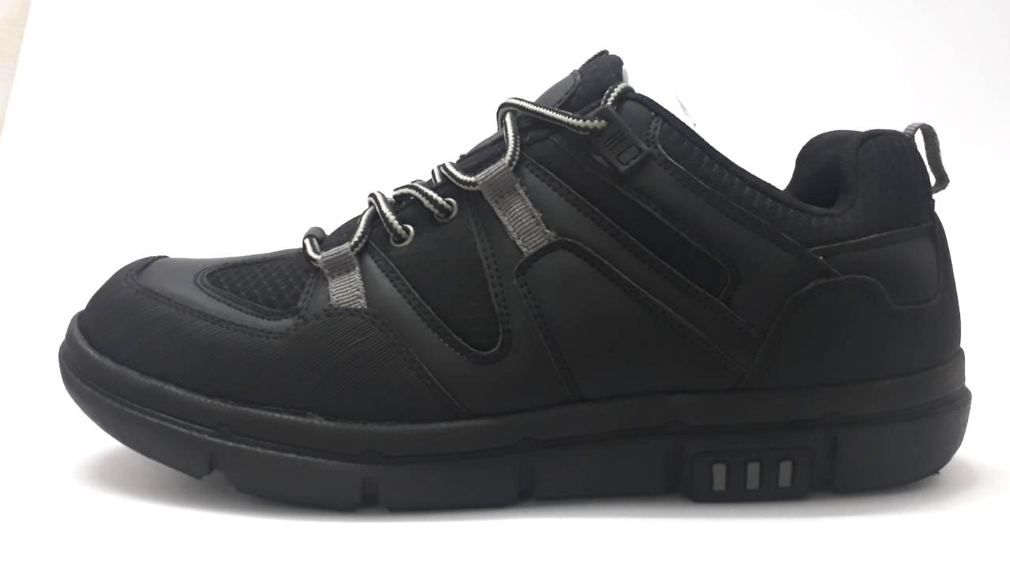
ART. NO | UPPER MATERIAL | COLOUR | LINING MATERIAL | SOLE
AW18-29A | PU SYN | GREY/BLK | SKINFIT | PHYLON WITH TPR RUNNER
ART. NO | UPPER MATERIAL | COLOUR | LINING MATERIAL | SOLE
AW18-29B | PU SYN | BLK | SKINFIT | PHYLON WITH TPR RUNNER

